Slide 1
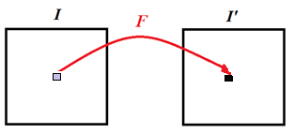
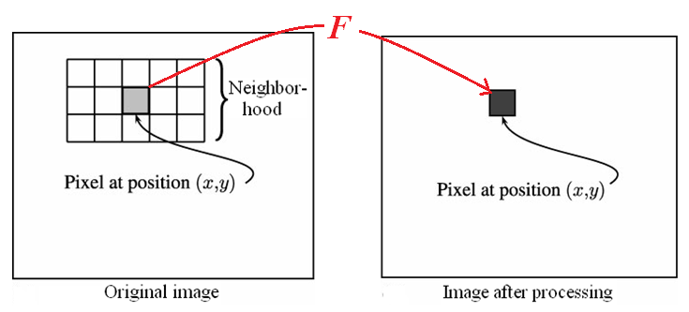
Chapter 5: Neighborhood Processing
Point processing: applies a function to each pixel
Neighborhood processing: applies a function to a
neighborhood of each pixel
5-<number>

Slide 2
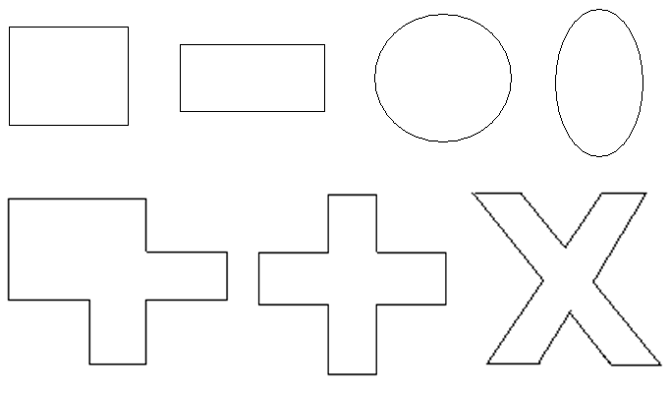

○ Neighborhood (mask) can have
Different shapes
Different sizes
5-<number>

Slide 3
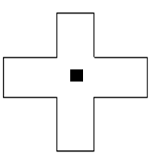
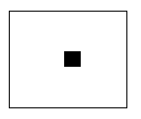
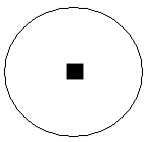
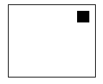
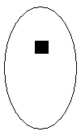

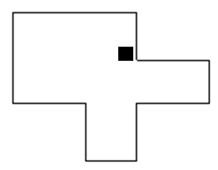
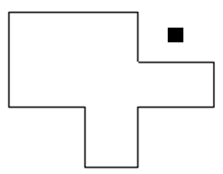
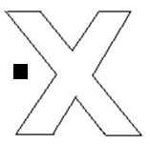
○ Define a reference point of a mask
5-<number>

Slide 4
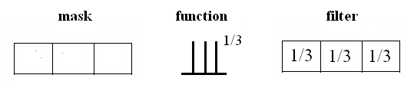
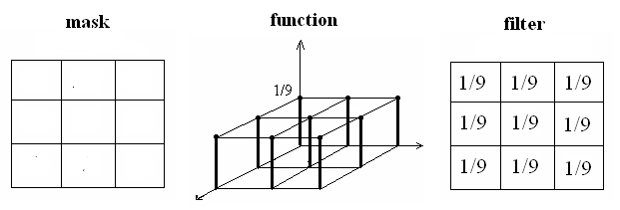
○ Mask + Function = Filter
1-D:
2-D:
5-<number>

Slide 5
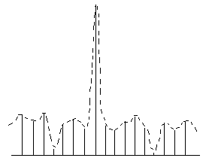


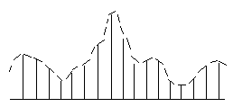
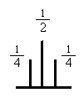
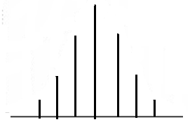
Example: Convolution
Input signal
Filter
Output signal
5-<number>

Slide 6
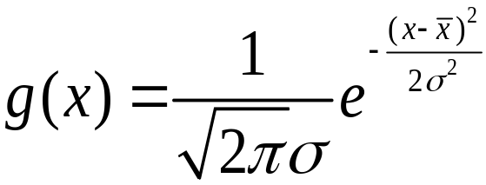
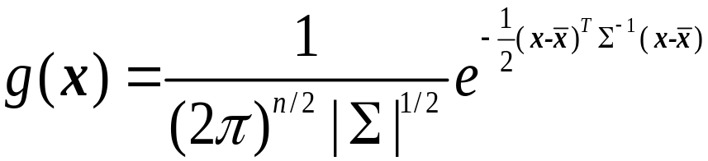
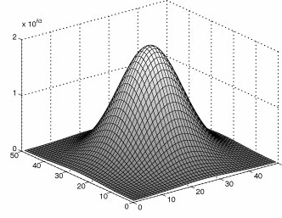
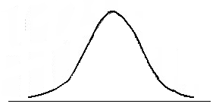
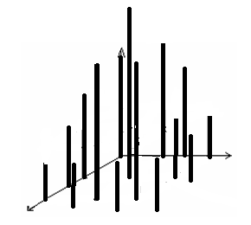
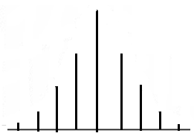
1D
2D
Continuous
Discrete
5-<number>

Slide 7
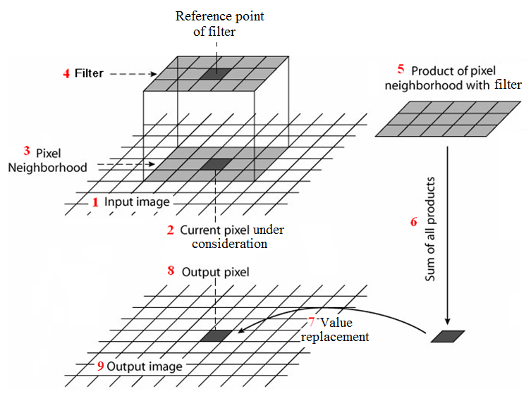
◎ Image Convolution: linear filtering through the
entire image
5-<number>

Slide 8
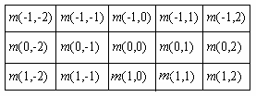
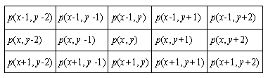
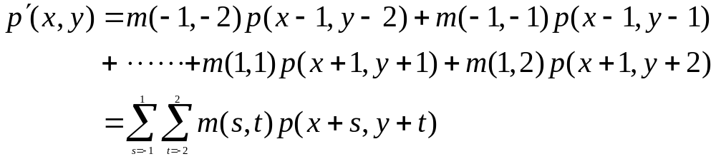
Mask
values
Pixel
values
5-<number>

Slide 9
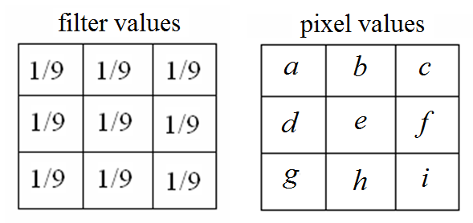
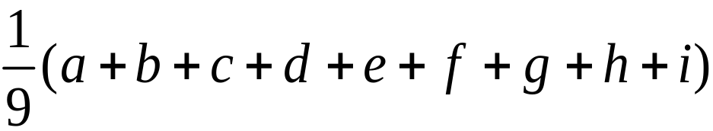
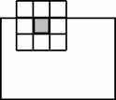
。 Example
○ Processing near image boundaries
Ignore the boundary
Pad with zeros
(c) Copy boundary
○ Values outside the range 0-255
Clip values
Scale values
5-<number>

Slide 10
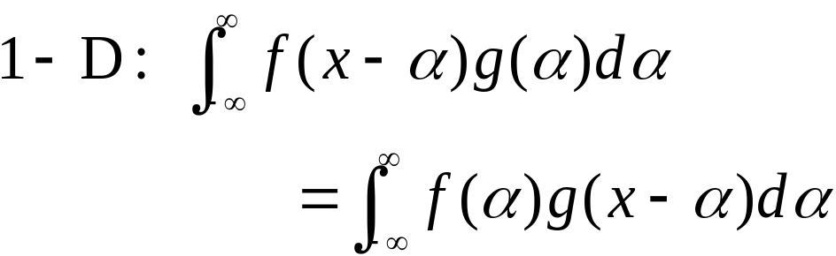
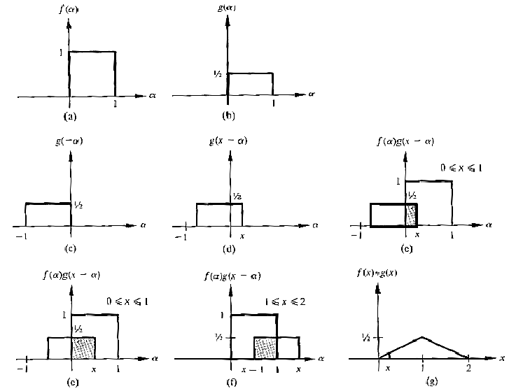
◎ Convolution
5-<number>

Slide 11
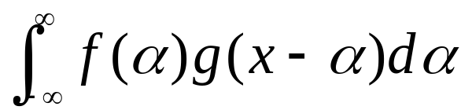




Summarize the process of convolution
1. Traverse
2. Move from
3. Calculate and record the overlapping area
between at every point.
5-<number>

Slide 12
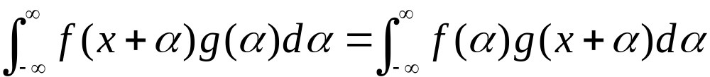
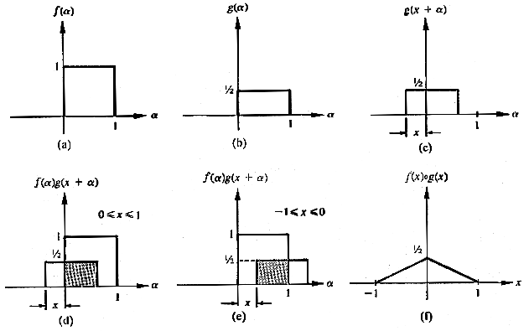
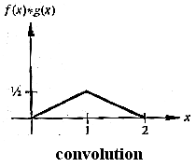
◎ Correlation
5-<number>

Slide 13
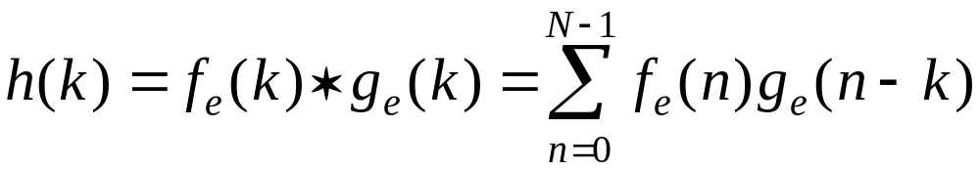

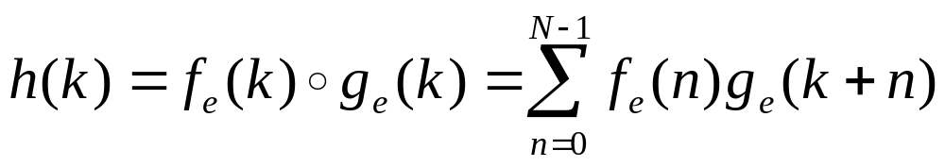
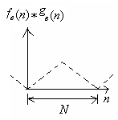
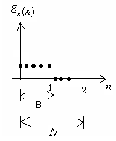

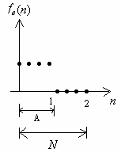
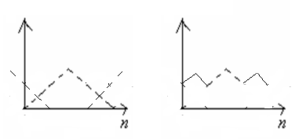

。 Discrete Case:
e.g.,
A = 4, B = 5, A + B – 1 = 8,
7-<number>

Slide 14
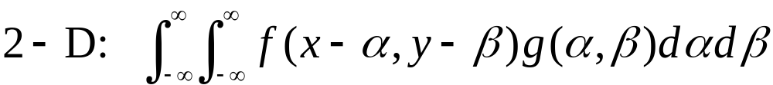
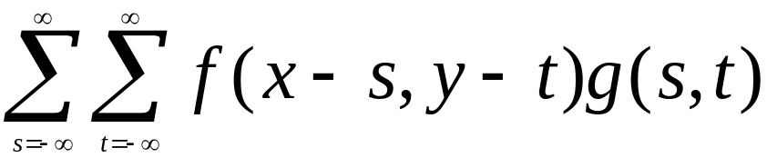
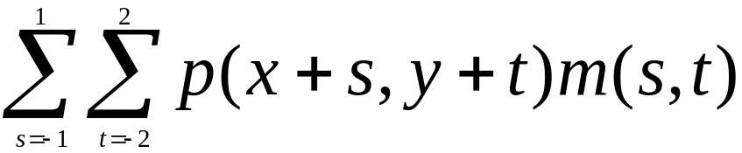

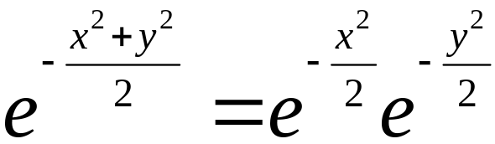
Discrete:
Compared with
Linear filtering:
○ Separable filters
e.g.,
7-<number>

Slide 15
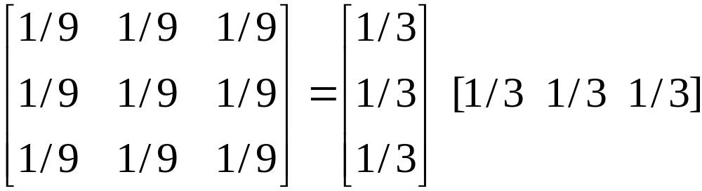
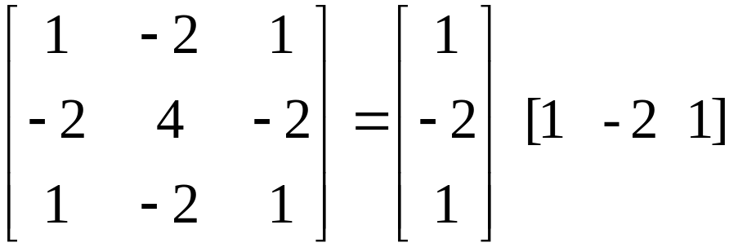




。 Example:
Laplacian
filter
n × n filter:
2 (n × 1) filters:
5-<number>

Slide 16
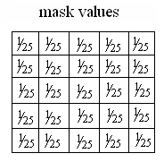
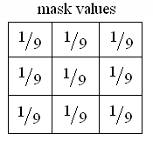




◎ Smoothing Filters
○ Averaging
filters
Input 3X3 5X5 7X7
5-<number>

Slide 17



○ Gaussian filters
(1-D):
(2-D):
5-<number>

Slide 18








Averaging filters
Gaussian filters
5-<number>

Slide 19



Frequency domain filters
Spatial filters applied
to the spatial domain
of the image
Frequency filters applied
to the frequency domain
of the image
Fourier transform
5-<number>

Slide 20






High pass filter
High frequency components, e.g., edges, noises
Low frequency components, e.g., regions
1-D case:
Spatial
domain
Fourier
transform
Frequency
domain
Low pass
filter
High frequency
components
Low frequency
components
5-<number>

Slide 21


High pass
2-D case:
Input image
Fourier transform
Low pass
5-<number>

Slide 22




5-<number>

Slide 23


◎ Edge Sharpening or Enhancement
○ Unsharp masking
5-<number>

Slide 24





。 Idea of unsharp masking
(a) Original signal
(b) Blurred signal
with original
shown dashed
for reference
(c) Unsharp mask
(d) Sharpened signal
obtained by adding
to (a)
5-<number>

Slide 25


。 Perform using a filter
5-<number>

Slide 26

。 Example:
(a) Original (b) Unsharp Masking
5-<number>

Slide 27


。 Alternatives
(a)
(b) The averaging filter can be replaced
with any low pass filters
5-<number>

Slide 28
○ High-boost filter
high boost = k(original) – (low pass)
= k(original) – ((original) - (high pass))
= (k-1)(original) + (high pass)
。 Alternatives:
i) (k/(k-1))(original) + (1/(k-1))(low pass)
ii) (k/(2k-1))(original) +
((1-k)/(2k-1))(low pass)
5-<number>

Slide 29

。 Example:
(a) (k/(k-1))(original) + (1/(k-1))((low pass)
(b) (k/(2k-1))(original) +
((1-k)/(2k-1))((low pass)
5-<number>

Slide 30





◎ Non-linear smoothing filters
Maximum filter
: mask elements
Minimum filter
5-<number>

Slide 31



。 Median filter
noise removal
edge preserving
5-<number>

Slide 32


。 Kuwahara filter
The output is the mean of the region with
the lowest variance.
5-<number>

Slide 33


。 K-nearest neighbors (K-NN)
。 Geometric mean filter
。 Alpha-trimmed mean filter
i) Order elements
ii) Trim off m end elements
iii) Take mean
5-<number>

Slide 34





◎ Region of Interest Processing
5-<number>

